Slide 1
Here is an app that teaches you how researches use laser and nanoparticles to treat cancer
Our programmer bailed so we decided to make an app for cancer patients that will get this treatment, from of the hype of pokemon go obviously people respond better to games, this will also introduce kids to concepts of physics (laser intensity, particle size, diffusion, heat transfer, frequency). due to lack of time since we started this today we only did “size of nanoparticle” but the same could be done for laser intensity and other physical attributes etc, with links to physics slide that explain concepts for adults too.
if you go to slide 4 and go to animation > animation pane > show advanced animation, you will see that there was a lot of coding envolved, this could easily be done on a programming software had we had a programmer
So without further ado, here is Nanomon Go,

Slide 2

NANOMON

Slide 3


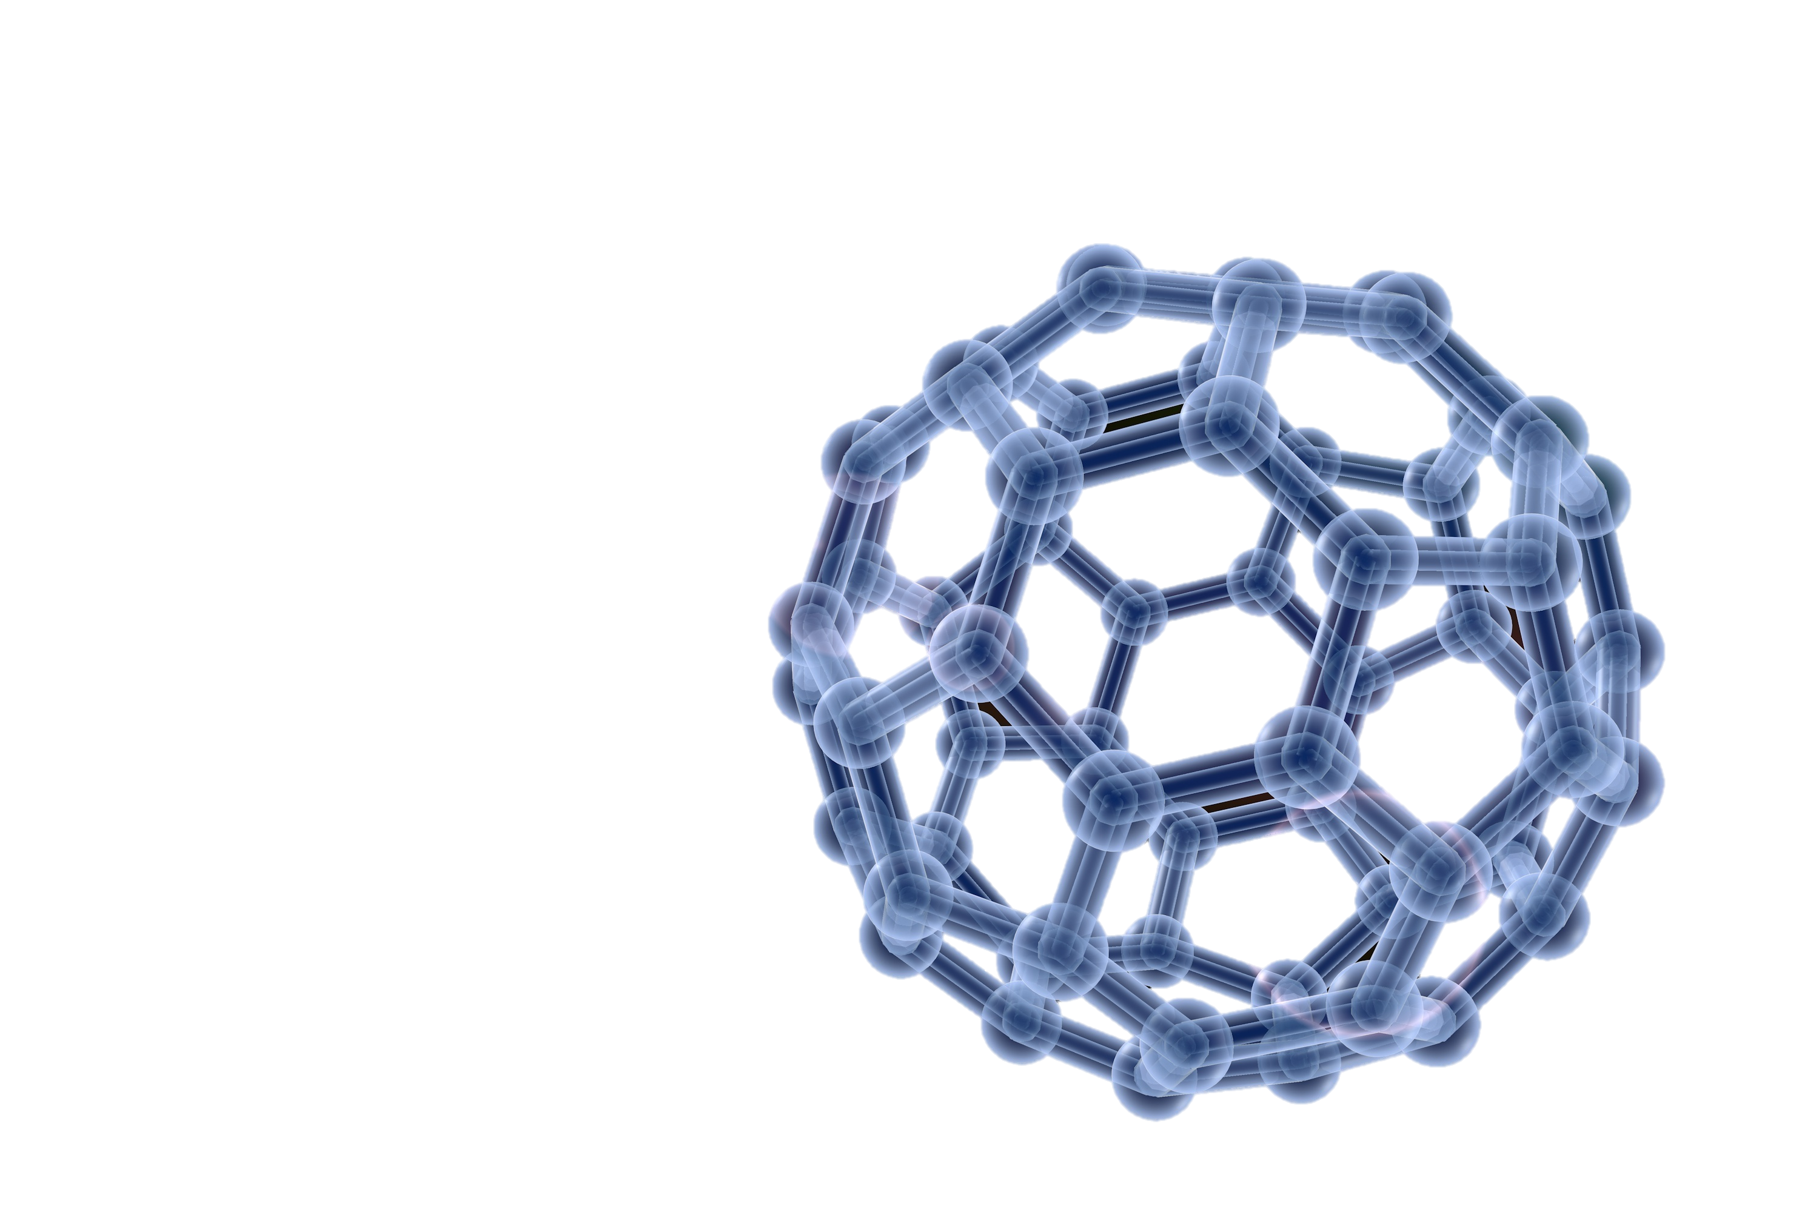
Your very own Nanomon legend is about to unfold!
Myself… I use Nanomon to fight cancer.
Some people use Nanomons in electronics. Other use them in laser beams.
This world is inhabited by creatures called Nanomon!
My name is Oak! People call me the Nanomon Prof!
"Hello there! Welcome to the world of Nanomon
A world of dreams and adventures with Nanomon awaits! Let's go!"

Slide 4
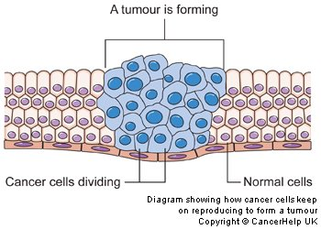











Nanomon take their energy from the laser and burn team tumor away!
Once on the tumor, I point a giant laser on the nanomon
Once inside they will find the mean team Tumor and bind to it
Due to their size they can penetrate the tiniest of cells
Nanomon or nanoparticles are super small creatures
First let’s talk about Nanomon!
Isn’t that cool ?! Let’s try it out !!

Slide 5
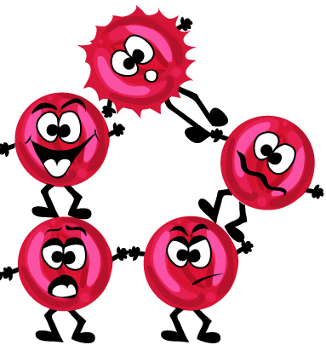

Here don’t click anywhere or it will go to next slide, please just click on the nanoparticles to see the code at work
NEXT
My cells are 10nm big, click on the Nanomon I should use
First help me choose a Nanomon
Great choice! Now my Nanomon can go inside, click on next to proceed
That is exactly what we need, the Nanomon, click on next to proceed
That is too big and won’t be able to penetrate the cell, pick again

